Slide 1
Creating in Libraries
Lessons learned working in low resource environments

Slide 2
When was the last time you went to a library?
Notes:
When was the last time you went to a library?
Raise your hand if you’ve been in the last year?
Keep your hand raised if you’ve been in the last 6 months?
OK, the last 3 months?
The last month?
The last week?
Would a few of you be willing to share why you were at the library?
To consume content? To create content? Or something else??

Slide 3
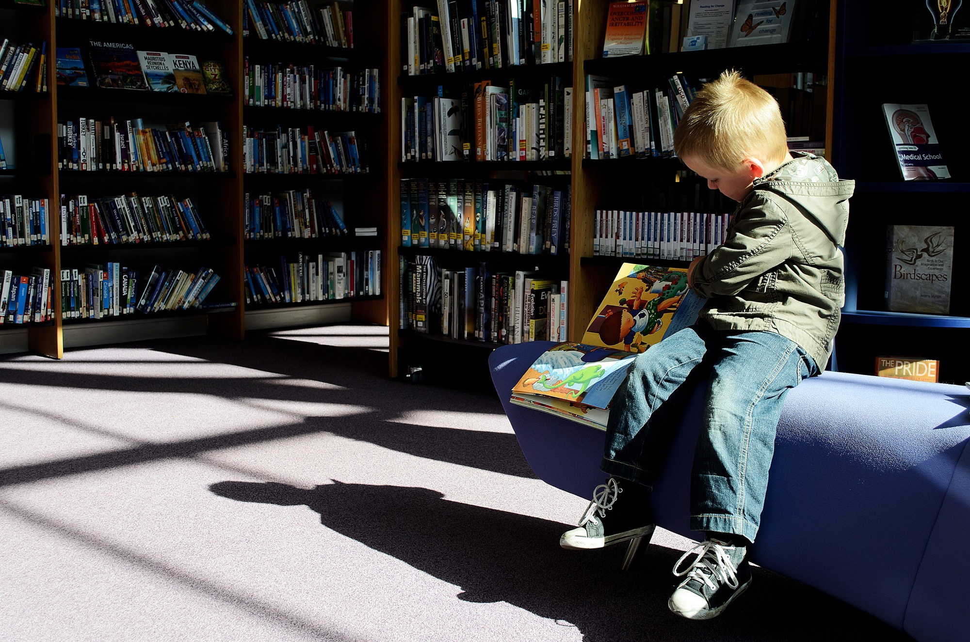
Throughout history, libraries have been a primary destination for content consumption.

Slide 4
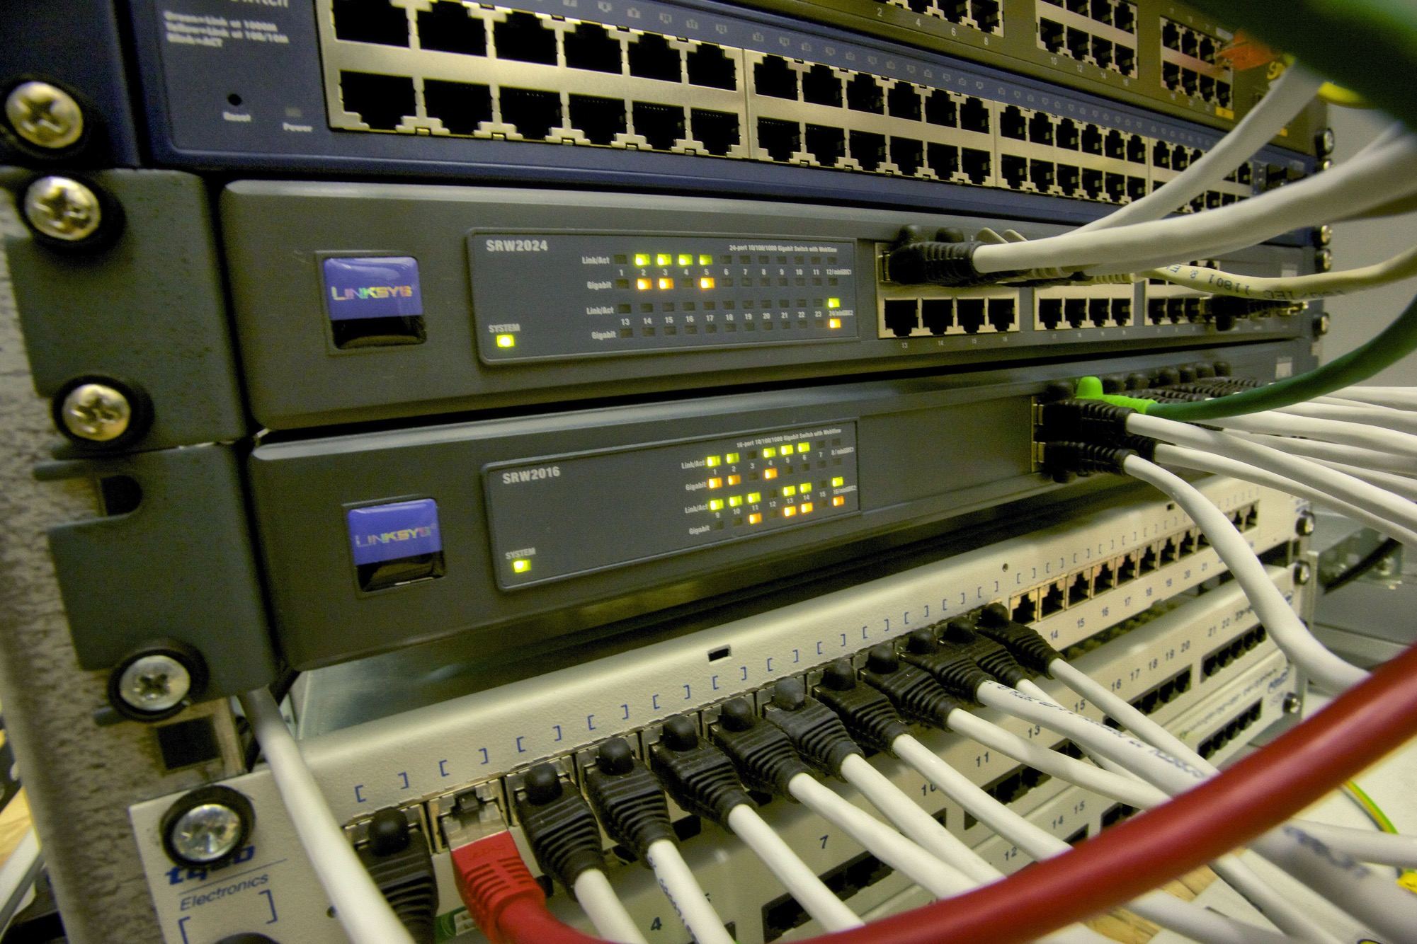
The internet has changed where people go for content.
Notes:
The internet has supplanted libraries as repositories for knowledge
Especially in countries where smartphone usage is very high, like Romania and Ukraine where I’ve worked overseas
When you need to look up some thing, where do you go first? Library? Computer? Phone? I would hazard a bet that most of us don’t take a trip to the library every time we need to look up something.

Slide 5
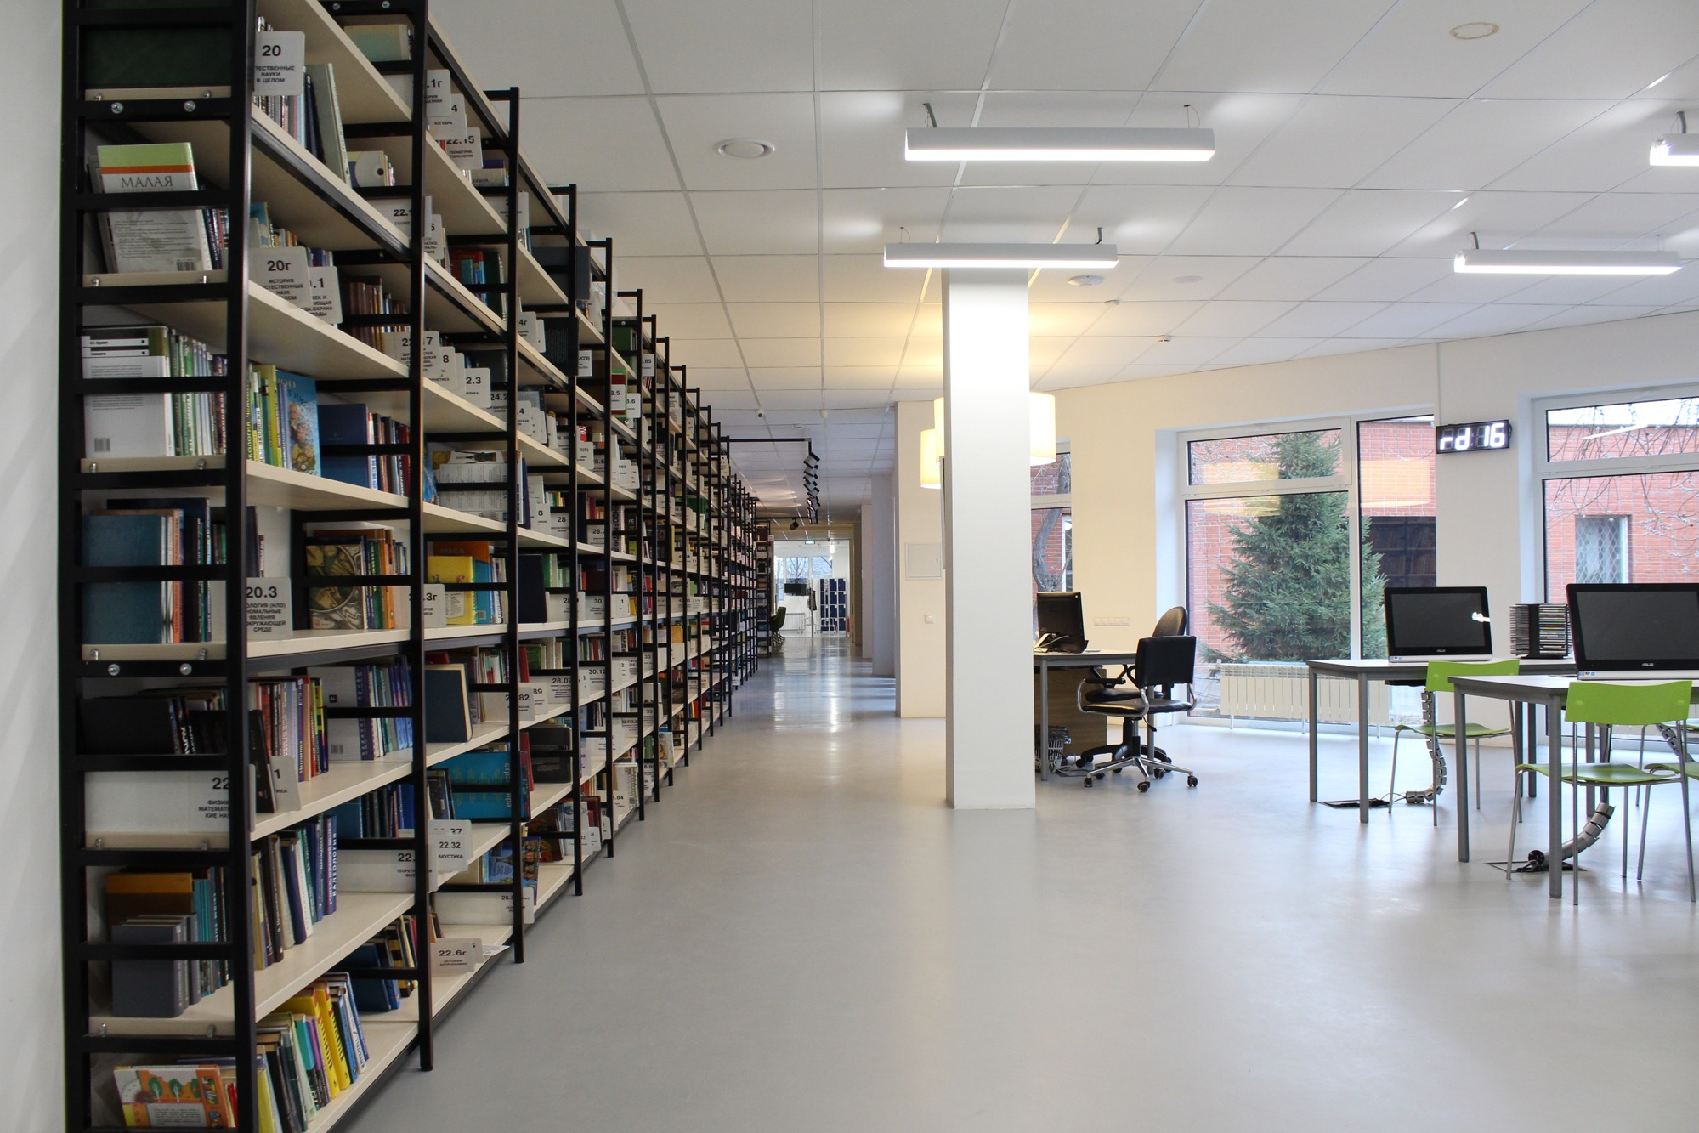
Libraries have had to change their services
to keep up with the changing world.
Notes:
Libraries have always been much more than dusty archives…but that has not alsways been what the public percieves
Libraries have a branding issue and they have to promote new services to combat that
Community activities
Workshops and programs (what we were doing in Ramnicu Valcea)
and

Slide 6
Moving beyond content consumption is
content creation…
Notes:
Content creation
This is happening around the world but most of the time these spaces are in high resource environments such as university libraries or major metropolitan libraries.
Maker Spaces movement across the US – a general description but COST?!?!?!

Slide 7
Low resources can make
library modernization quite difficult.
Notes:
It can be really hard to get the funds for library modernization in low resource environments and to get the buy-in from community leaders, particularly in areas of the developing world where available resources are spread thinly and corruption abounds.

Slide 8
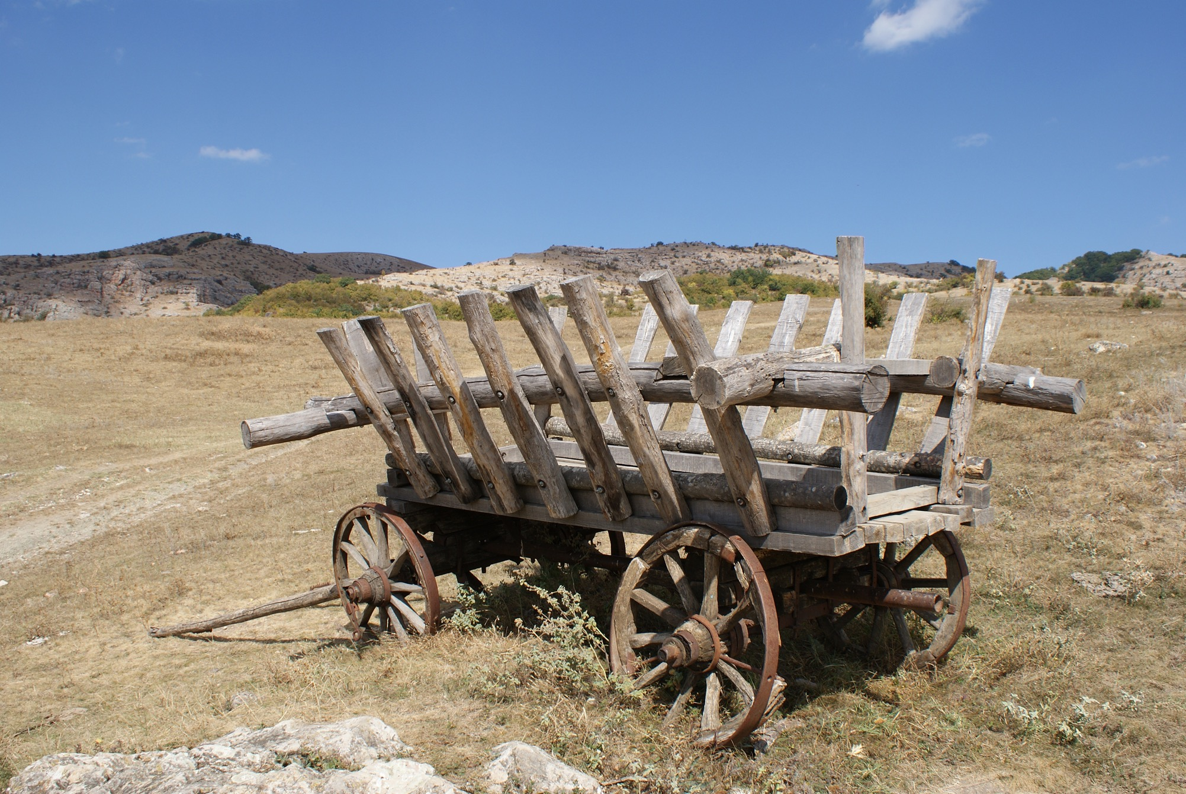
In rural Ukraine, low resource means:
Lack of funds
Lack of time
Lack of knowledge/skill
Lack of infrastructure
Notes:
In rural Ukraine the libraries can barely afford books
The librarians are over worked and understaffed
They have been working at the same library for 40 years and do not have the knowledge or will or incentive to change
Internet is often weak in rural areas and the roads prevent easy access to the library.
Often leaders and communities don’t see the value added to society by the library.
Learning and implementing technology can be intimidating and time-consuming for folks.

Slide 9
What kind of resources run low in your workplace?
Notes:
What sort of low resources do you run into in your workplace?
If no one is willing to respond…...
Stand up if.... Your organization struggles with....
Funding (for staff, for materials, for projects)
Time for new projects
Knowledge and skills for implementing projects
Infrastructure (like buildings, access to internet)
Even in a resource rich country like America, we still have difficulties with resources. So hopefully some of the lessons my team and I learned implementing this project in Ukraine will have some applicability here in the US.

Slide 10
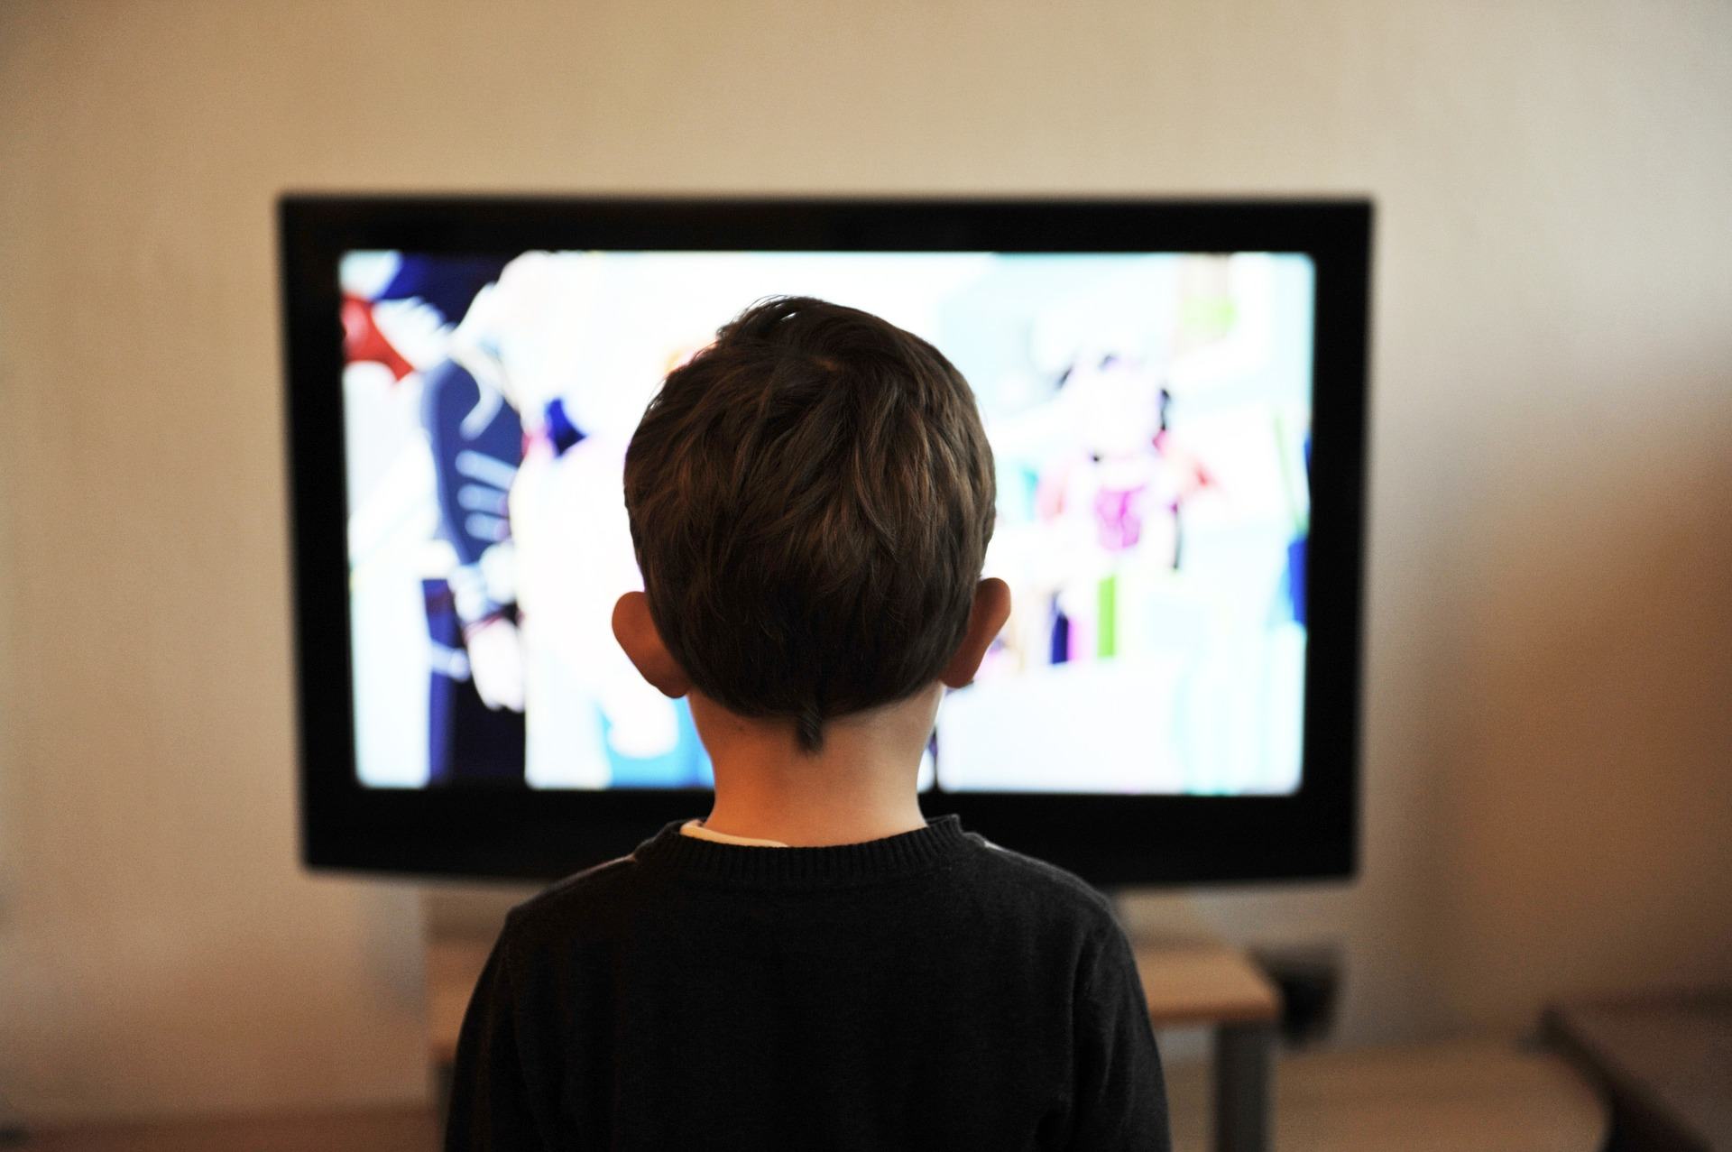
Ukrainian libraries need to increase patronage
and prove their value to their communities.
Notes:
Even in this tough environment Ukrainian libraries have to increase their value to the community and gain additional patrons so that they can remain viable in today’s culture.
Almost 20K libraries in Ukraine, competition is fierce for the small pool of funding

Slide 11
As a pilot, Bibliomist in Ukraine worked with
five libraries to
install “creation spaces”.
Notes:
As a test this project, inspired by the Maker Spaces movement, was implemented. These space were designed for creation and were focused on audio, video and photography as those domains were seen as more cost-effective in Ukraine.

Slide 12
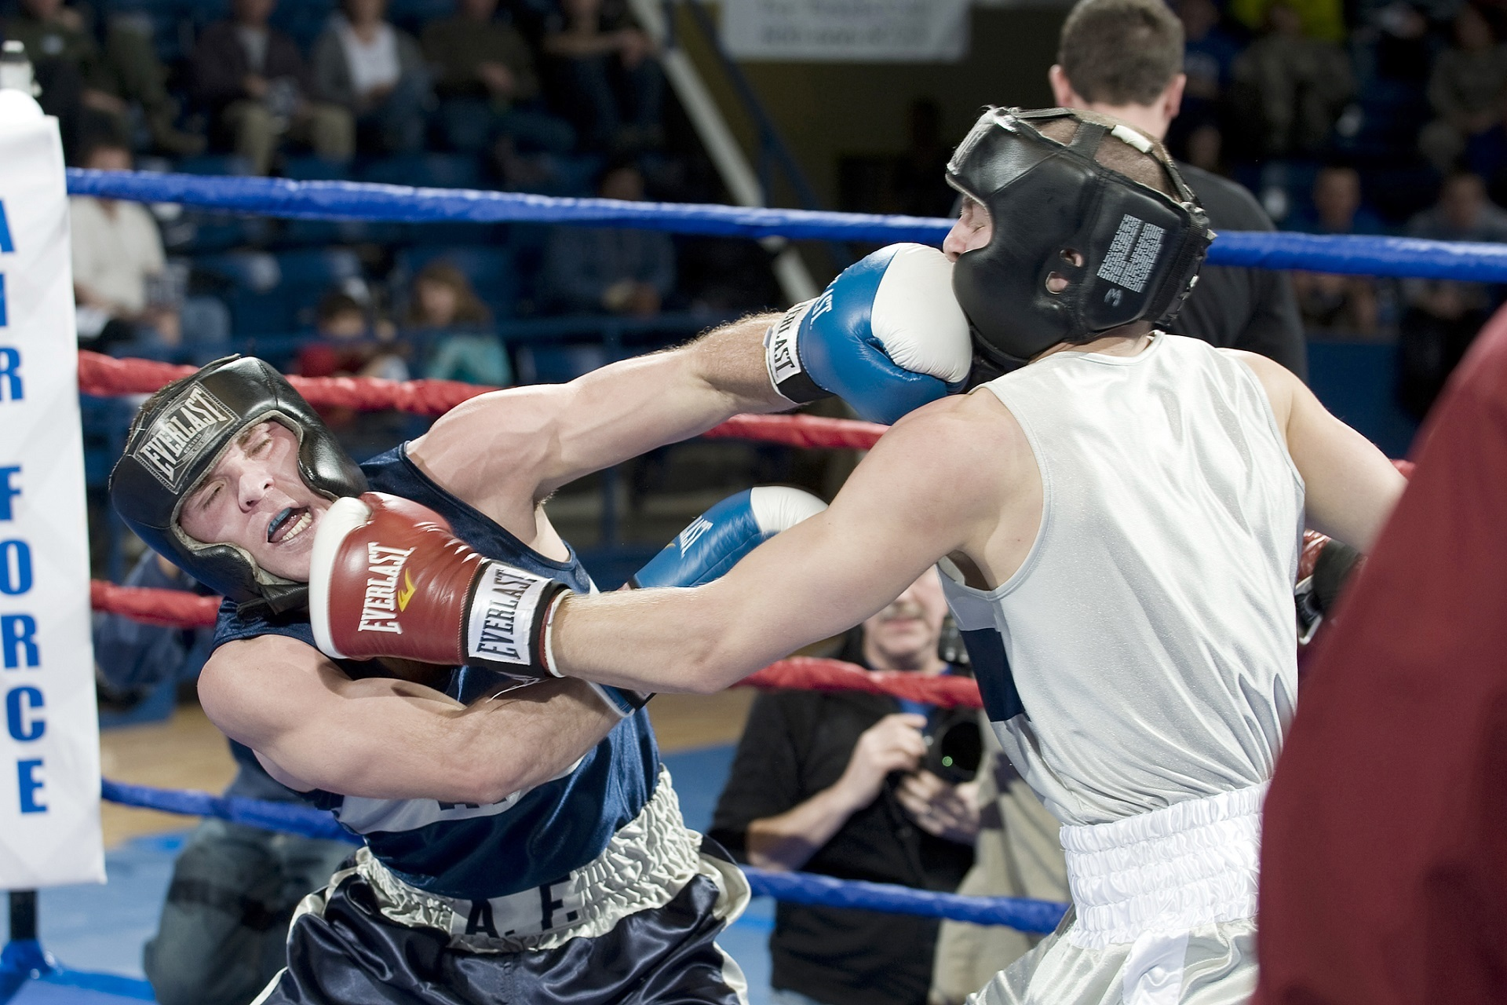
Libraries competed against one another for five grants and training opportunities.
Notes:
With 20K libraries in Ukraine and 2,000 equipped with computers by bibliomist, it was impossible to do something for every library….so Bibliomist introduced this pilot project as a contest.
They had to submit a proposal and were judged based on their merits

Slide 13
Contest Rules
A community partner
A dedicated space
A detailed project plan
Notes:
Basic rules were simple: had to have 1 community partner, a dedicated space in the library, and a detailed project plan
These were more difficult than anticipated…many could find a partner, many didnt have a dedicated space, and the project plans were a disaster

Slide 14
Cash and Prizes!
Up to $5,000 in equipment
2 trainings
Site visits
Notes:
The 5 winners received…5,000 in equipment....they were allowed to pick what they wanted...but it had to be approved by grant coordinator.
They received 2 technical trainings (also a project planning course)
And an international site visit (this would not be necessary in the US)

Slide 15
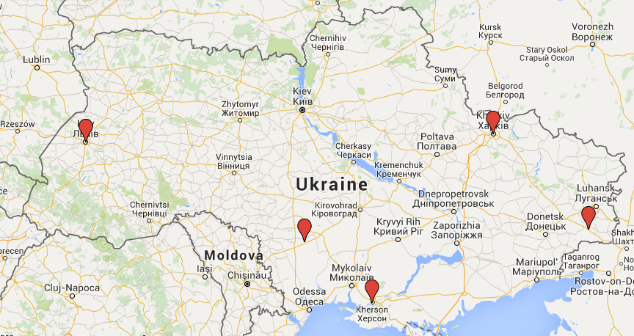
Notes:
A map of Ukraine to show where the 5 sites are
3 of them in somewhat dangerous areas

Slide 16
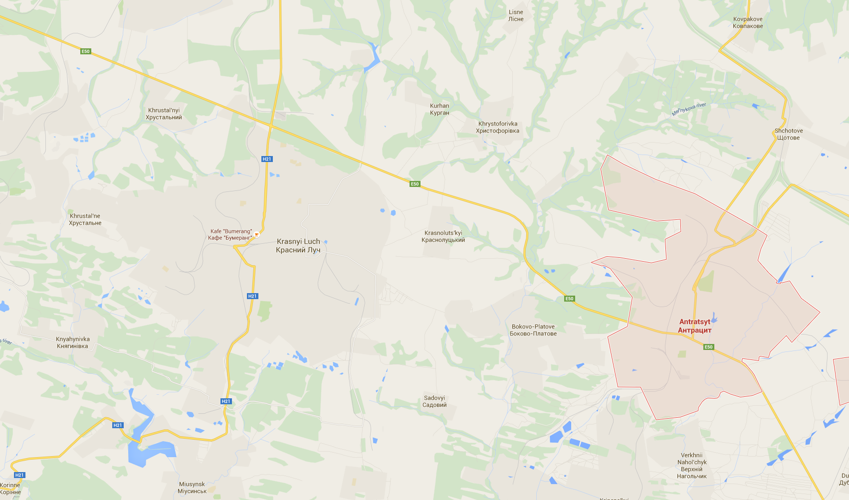
Site #1: Antratsyt
300 participants
510 new patrons
4 public concerts
$2,000+ in donations
Notes:
Crazy successful
Massive community buy-in
Librarians got it
Paid community partner - led to more trainings

Slide 17
Site #2: Kharkiv
5 families participated in project
Less participants than projected
Family friendly space
Expert led classes
Dedicated social media space
Notes:
Did not aim for high participation and did not set up the infrastructure to achieve high participation
Best use of social media
Took a long time for the librarians to learn the equipment

Slide 18
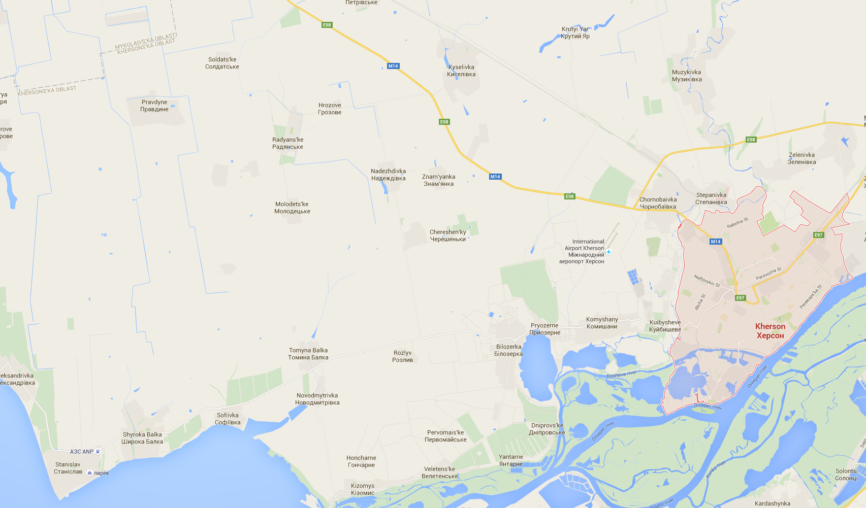
Site #3: Kherson
36 youth participants
Over 1,000 patrons benefited from the space
Equipment available for checkout
Notes:
Successful use of community partners
Enthusiastic participation
Many viewings and showings
Used a needs analysis to target the project

Slide 19
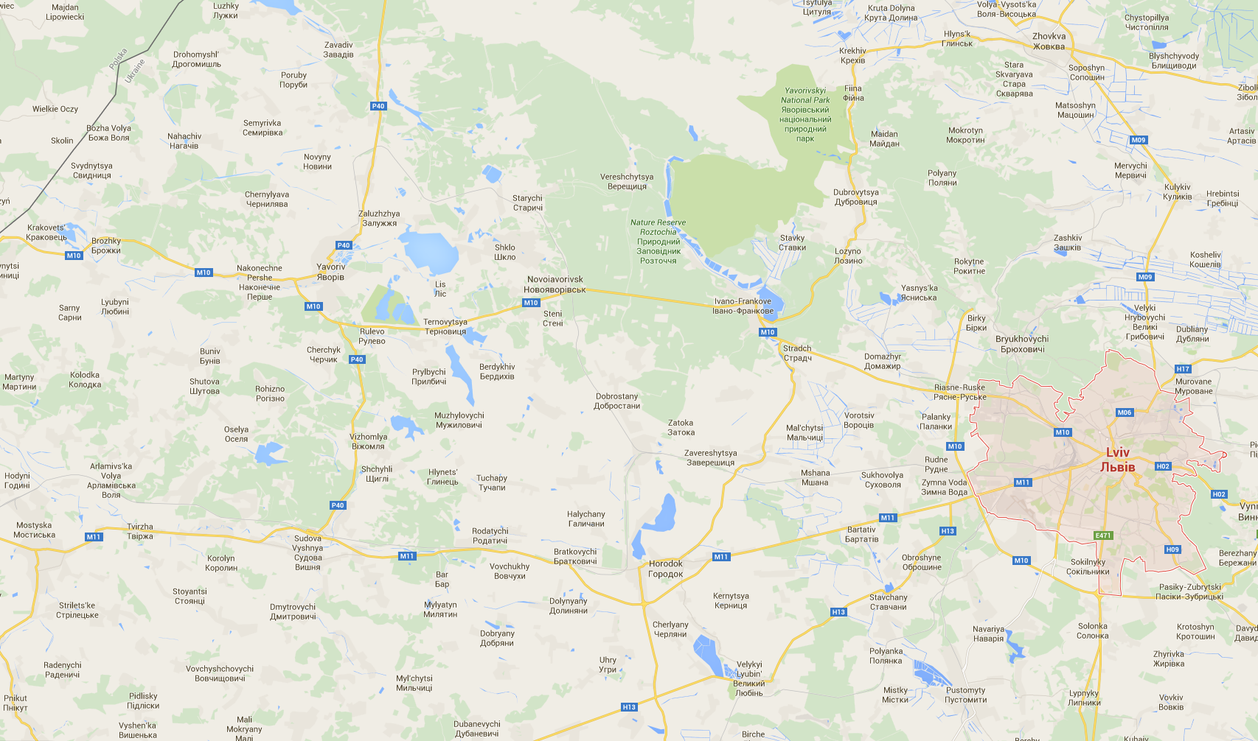
Site #4: Lviv
Exclusively for youth
Select group of youth participated
Focused on training and concerts
Notes:
Youth library
Equipment used in and out of the library for performances
Used concerts to become an entertainment destination

Slide 20
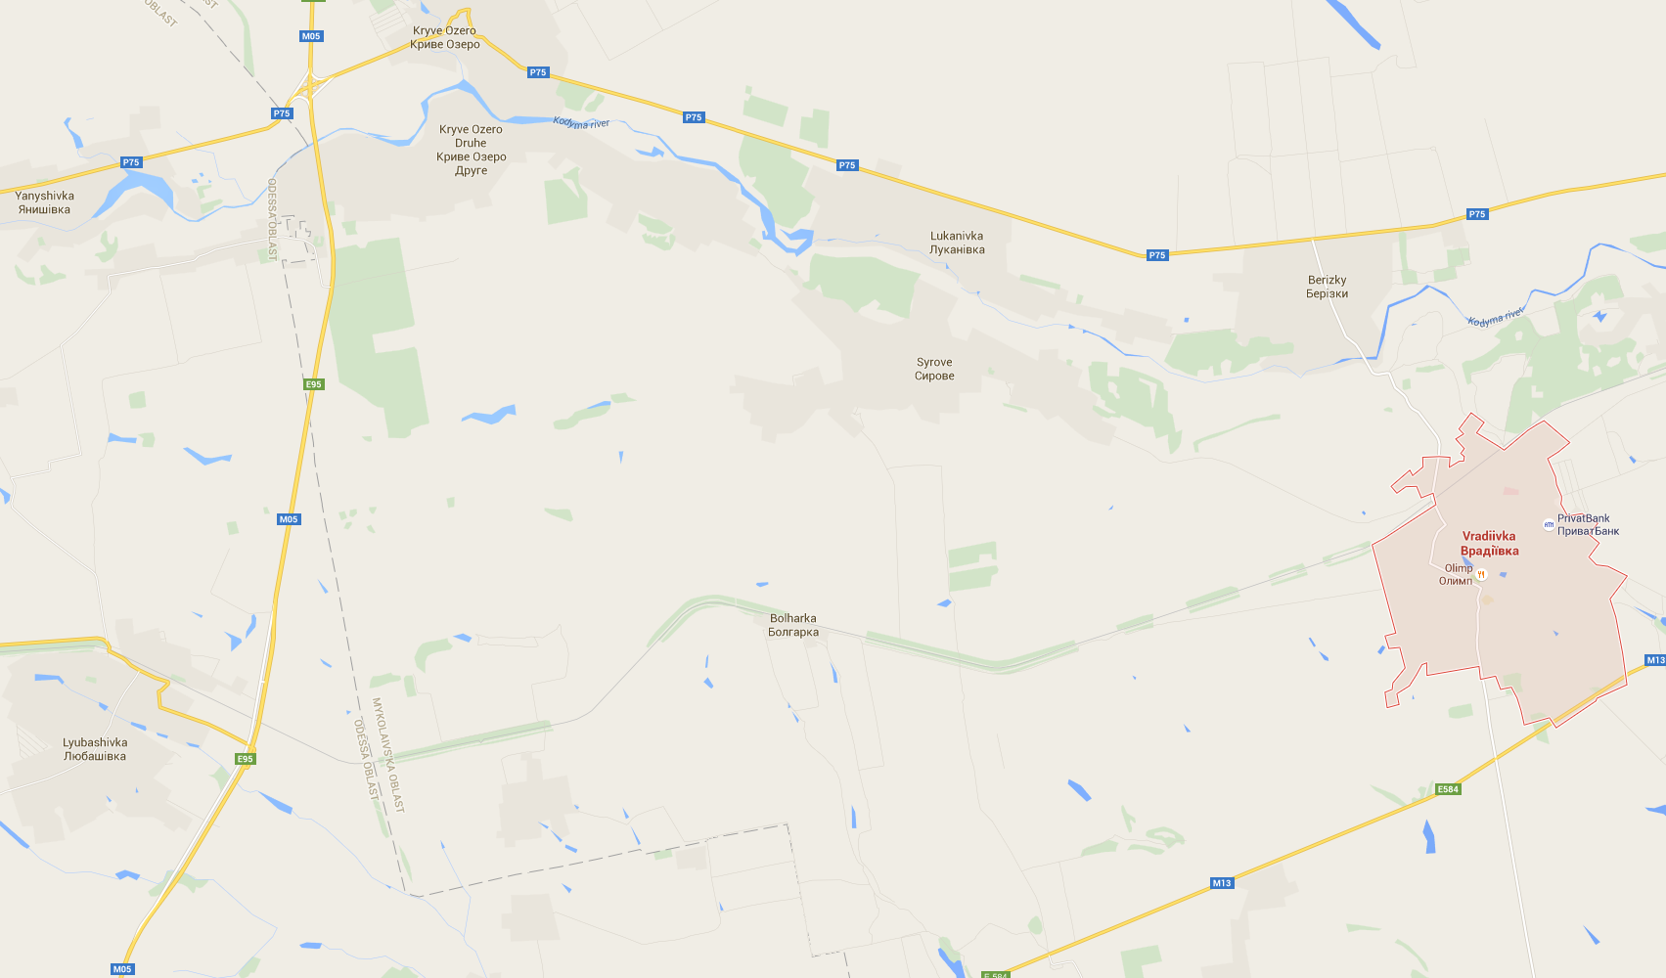
Site #5: Vradiivka
Youth
Television production
Broadcast on TV
Notes:
Focused on a small group
Partnered with local TV station
Showed that qualitative is as important as quantitative

Slide 21
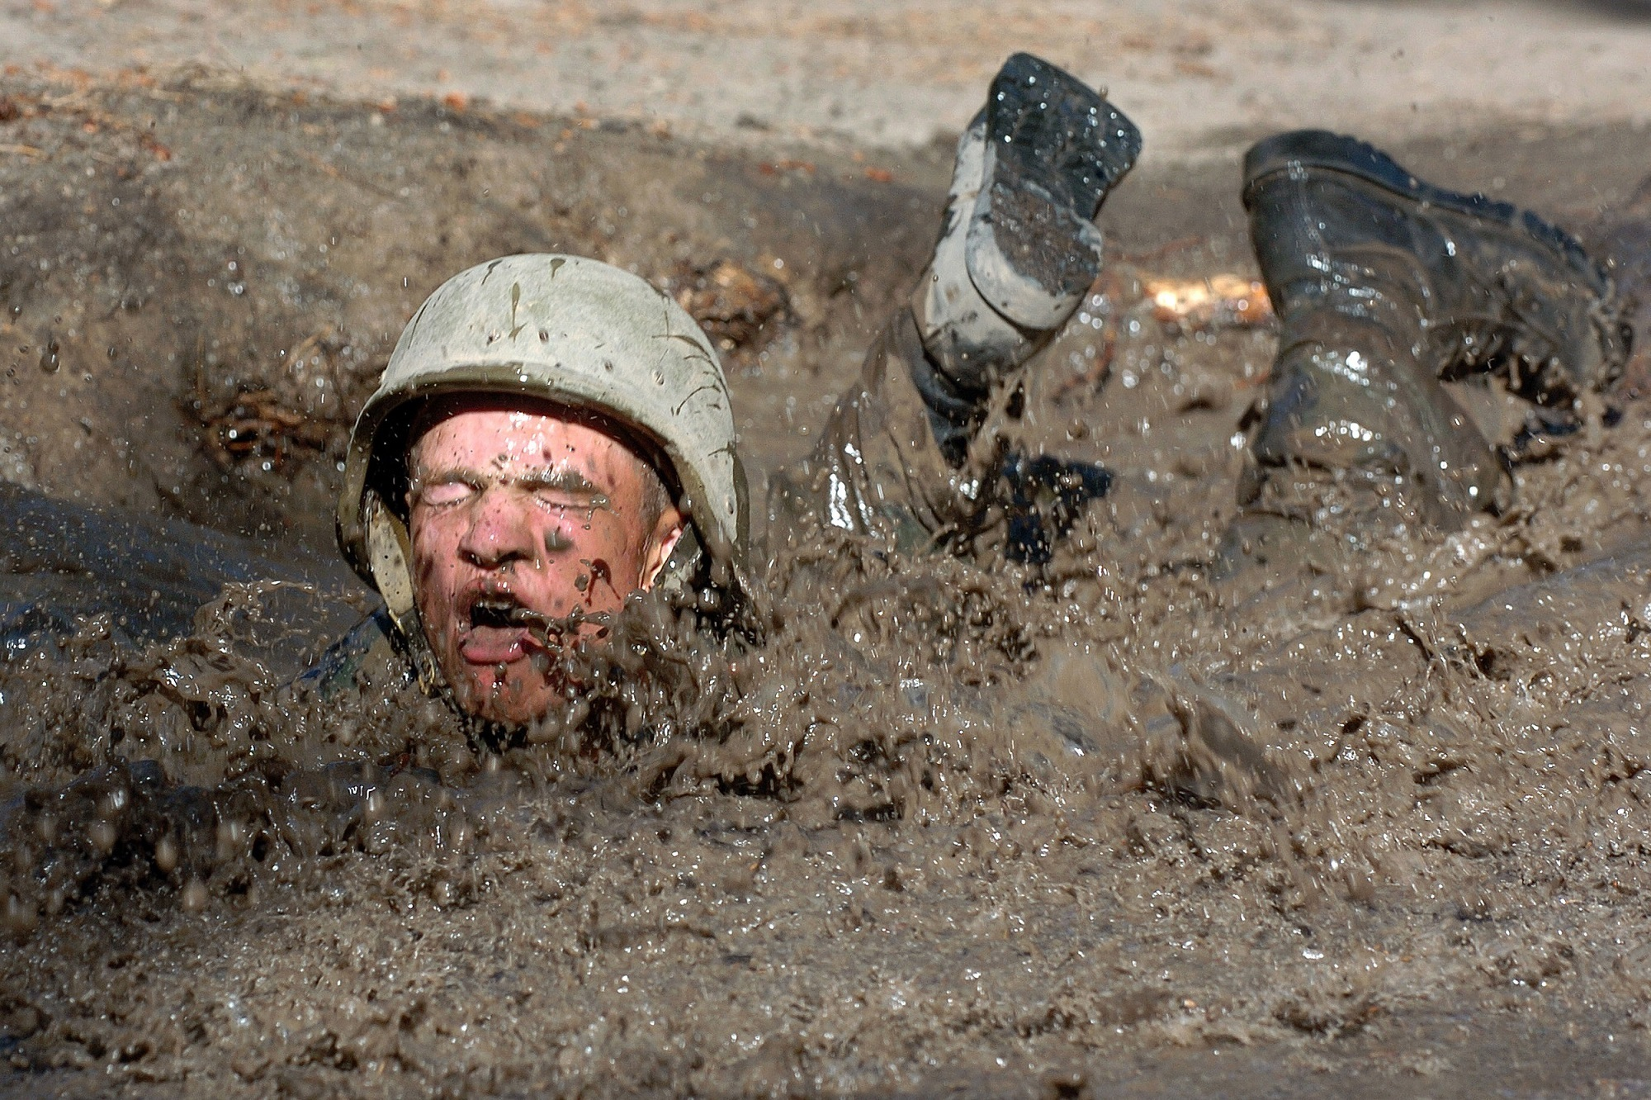
Challenges
Procurement
Contest
Librarian Buy-in
Knowledge
Resources
Notes:
Procurement: not the norm, hard to implement
Contest: low turnout, 43 applicants
Buy-in: Librarians scared of the equipment, maintenance, did not want patrons to use it or borrow it, librarians took the equipment for their use, staff had problems with maintenance, staff did not know how to manage the equipment
Knowledge: low understanding of the equipment and potential uses
Resources: no budget for the increased utility costs, no space for the equipment

Slide 22
Super Lesson
Community partners!
Notes:
#1 lesson learned…these projects lived and died based on the strength of their partners
When staff time is low and resources are hard to find...these partners gave time and and treasure to help the community
Volunteerism = new & shiny!

Slide 23
Lesson 1
Motivated to create
Notes:
Both staff, adults and children were all motivated to use the spaces and create art

Slide 24
Lesson 2
Flexible solutions required
Notes:
Every space was different…they were encouraged to tailor their space and projects based on theior communitiues and reources

Slide 25
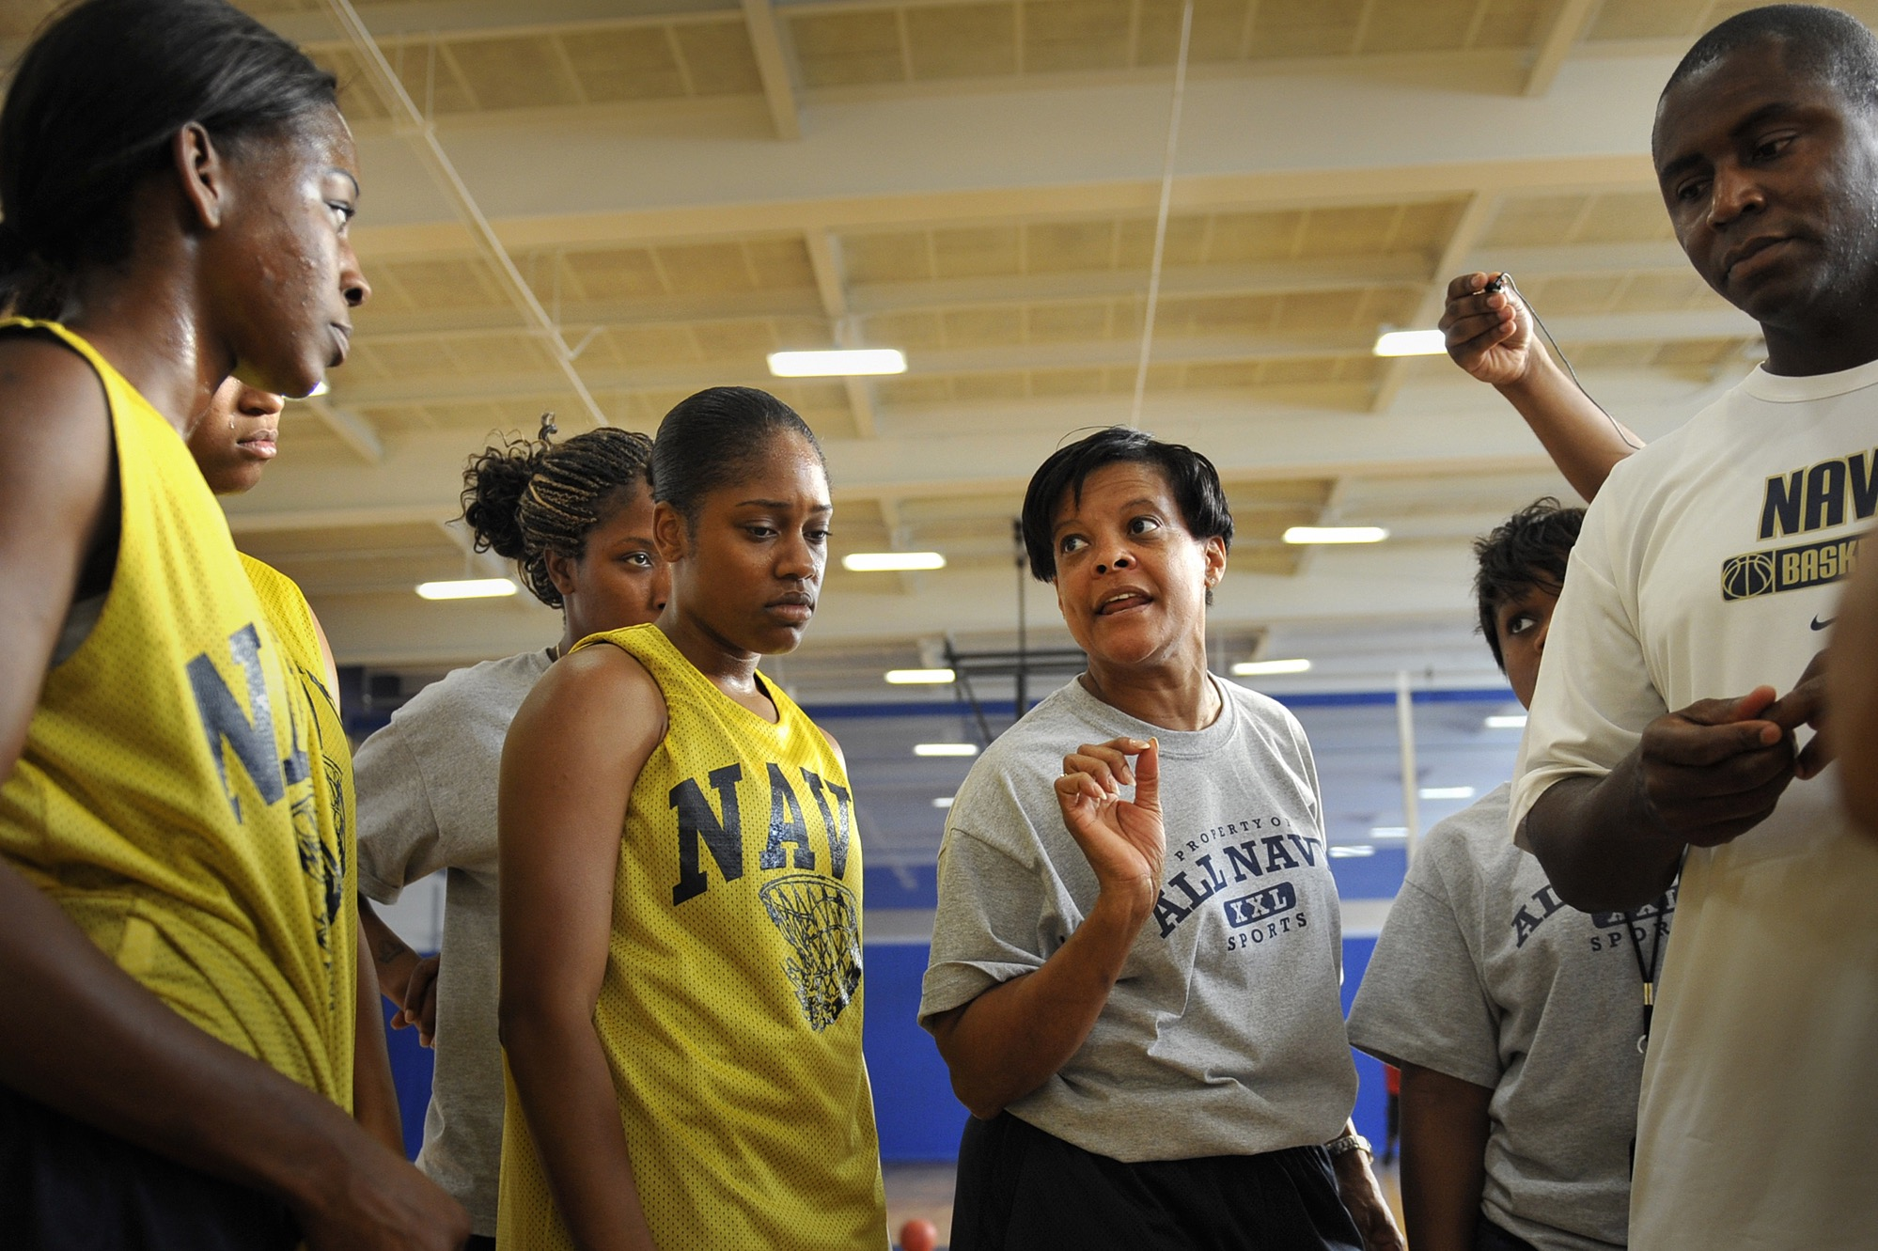
Lesson 3
Need strong leadership
Notes:
The spaces with the most dedicated and enthusiastic leaders had much more success
Strong (and forward-thinking) vision
Ability to mobilize staff to work as a team
Can identify staff strengths and empower them

Slide 26
Lesson 4
Access to equipment
Notes:
Sites that opened up access to the equipment saw higher numbers of patrons and increased participation
Also sites that posted clear guidelines had fewer issues

Slide 27
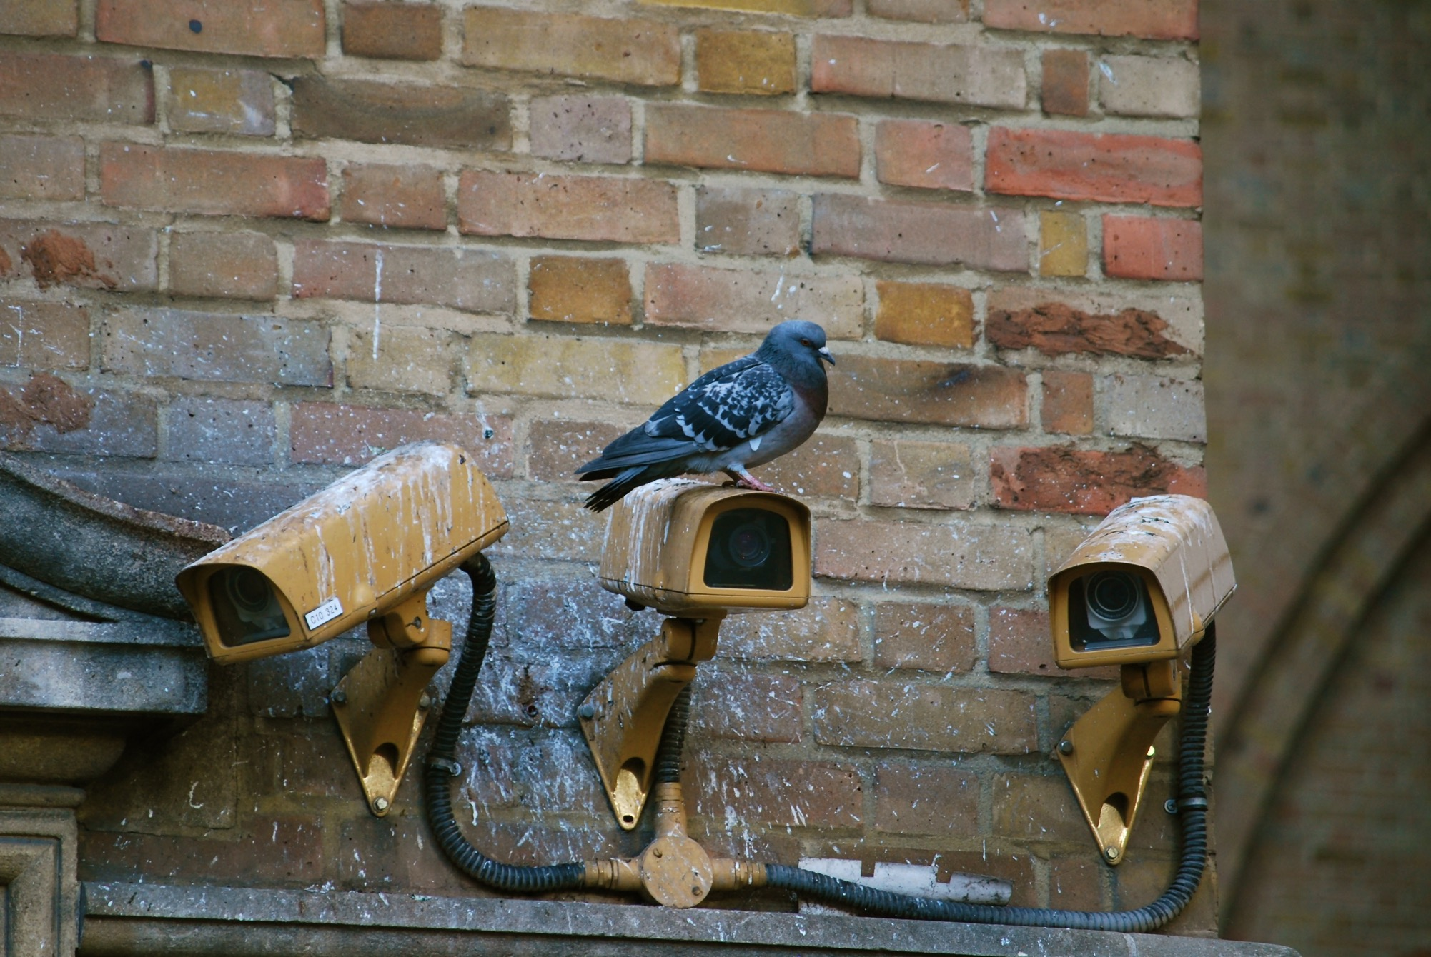
Lesson 5
Monitor usage
Notes:
This equipment was new to the librarians and patrons…it was important fopr the librarians to monitor the patrons and for the patrons to monitor the librarians...to make sure the equipment was used correctly and to make sure the equipment was availalble.
Mutual accountability = decrease theft and decrease corruption

Slide 28
Lesson 6
Knowledge base
Notes:
This project required extensive training for the librarians…all new equipment...all new services...they were nervous and reluctant to us ethe equipmnt and let the patrons use the equipment

Slide 29
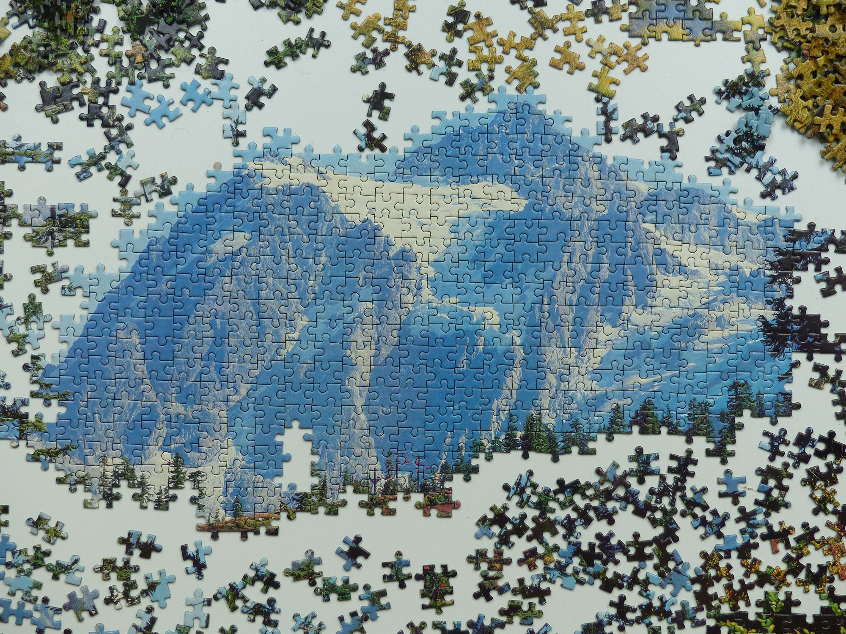
Lesson 7
Patience, always
Notes:
Originally the projects were supposed to last a few weeks
Eventually they lasted from 6 months to a year (and there was a little revolution in the middle of it all!)
It took that long for the librarians to fully feel comfortable offering the new services

Slide 30
Questions
Ideas
Success Stories
Notes:
Originally the projects were supposed to last a few weeks
Eventually they lasted from 6 months to a year
It took that long for the librarians to fully feel comfortable offering the new services

